Slide 1
The Course
In GCSE History we will cover the following topics. You will note that this is a change from the originally advertised programme of study – we have decided that Conflict and tension in Asia, 1950-1975 works better with the America unit:
Paper 1 (taught in Year 10):
America, 1920-1973: Opportunity and inequality.
Conflict and tension in Asia (Korea and Vietnam), 1950-1975.
Paper 2 (taught in Years 10 and 11):
Migration, empires and the people, c.790 to the present day.
Norman England, c.1066-c.1100.
Both papers will be sat at the end of Year 11 and are each worth 50% of the final grade.

Slide 2
Assessment
All the questions in your exam papers can be divided into two aspects of assessment which you will need to learn.
These two aspects reflect the Assessment Objectives (AOs are the key skills on which you will be examined).
•Aspect 1: Demonstrating knowledge, understanding, analysis and explanation (AO1 and AO2)
•Aspect 2: Handling sources and interpretations (AO3 and AO4)

Slide 3
Requirements
What are the requirements for GCSE History?
AOs | Weighting | Target
A01 | 35% | Knowledge and understanding
AO2 | 35% | Analysis and explanation of key second order concepts (change and continuity; significance; cause and consequence; similarity and difference)
AO3 | 15% | Source analysis (pieces of evidence that have been produced around the time of the event under study)
AO4 | 15% | Interpretations (deliberate attempts to make sense of and explain the past that have been created after the events)

Slide 4
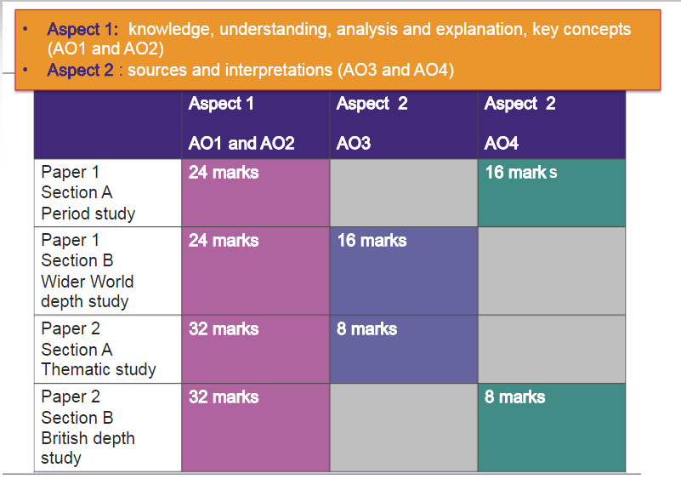

Slide 5
Three stages of historical thinking
Identify | 2. Explain | 3. Evaluate
State and/or describe relevant causes, consequences, similarities. | Use extended reasoning (How? Why? With what consequences? In comparison with) and knowledge to demonstrate an understanding of second-order concepts. You may also show understanding of the chronological order of events and any connections between them. | Reach a balanced, relevant and justified judgement.

Slide 6
The skills
Study your photocopy of the key skills from an AQA revision guide.
There is a lot of stuff and a lot of skills to learn, but with time effort and patience we will get there!

