Slide 1
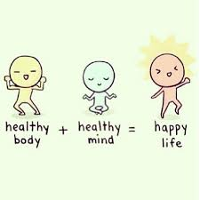
Reasons for and benefits of having a healthy, active lifestyle (HAL)

Slide 2
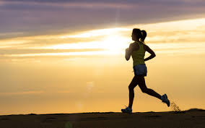
What is a healthy, active lifestyle?
A lifestyle that contributes positively to physical, mental and social well being.

Slide 3


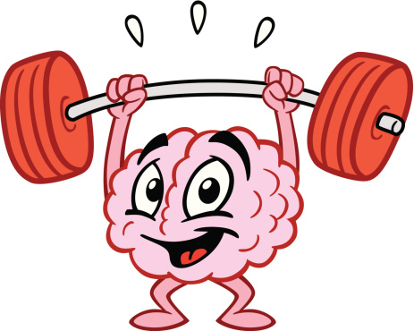
Reasons for and benefits of taking part in physical activity fall into three main categories
Physical
Things to do with your body
Mental
Things to do with your mind
Social well being
How you interact with others

Slide 4
Benefits of a Healthy, Active Lifestyle include. More benefits or reasons are highlighted in red
Physical | Mental | Social
Physical Fitness – develops C, M, M, F, B | To Help Feel Good – exercise produces serotonin | Development of friendships and social mixing
Physical Health – reduces CHD, osteoporosis, obesity, and stroke. | To relieve stress and tension – takes mind off of problems | Cooperation
Physical challenge | To increase self esteem and confidence – achievement make you fell better about yourself, also body change e.g.. lose weight
 | For enjoyment – sport is fun
 | Competition
 | Aesthetic appreciation
These are all benefits but some are also reasons (in red) for participating
6 Benefits
5 Reasons

Slide 5
Description of reasons
Reasons
Cooperation – being part of a team, teamwork and listening to others
Competition – competing against others and yourself
Physical challenge – doing something difficult is satisfying (mentally also)
Aesthetic appreciation – some moments in sport may be beautiful
Development of friendships and social mixing – fell part of something, less isolated

Slide 6
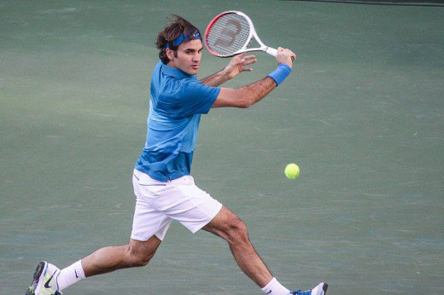
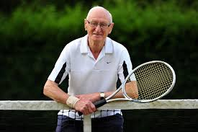
Examples
Describe two physical fitness benefits this person will gain from participating in sport (2marks)
He will develop his cardiovascular fitness (1) and muscular endurance (1)
Describe one reason why this person would participate in sport (1 marks)
One reason would be to develop friendships and socialise with others

