Slide 1
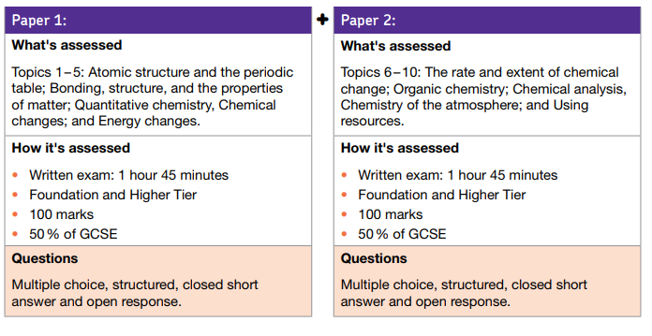
GCSE Chemistry
Full AQA specification here
GCSE videos
(click logo)
17th May 2018 (am) 13th June 2018(am)
Revision Book: Collins (science office has some)
Online textbook: Kerboodle
Online revision material: BBC Bitesize, Doddlelearn
OLD EXAM PAPERS – Different syllabus, mostly same chemistry!

