Slide 1
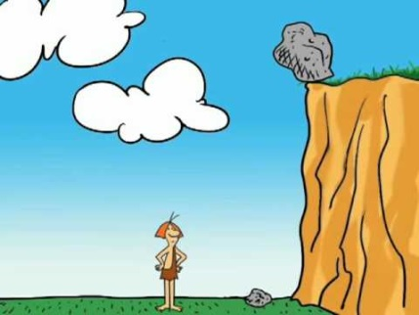
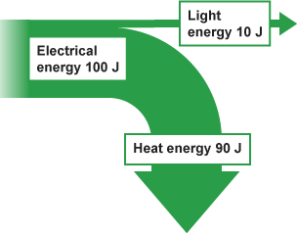
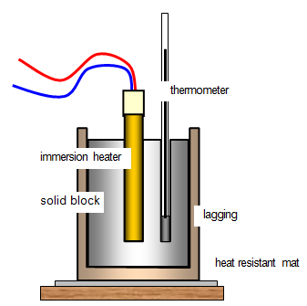
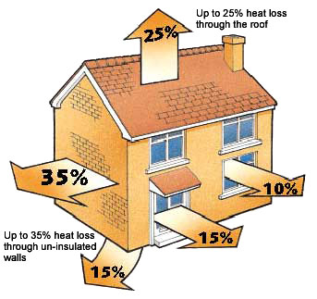
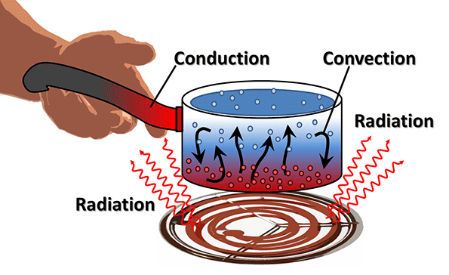
P1: Energy
Equations:
Gravitational potential energy
Elastic potential energy
Kinetic energy
Work done
Power
Power
Specific heat capacity
Energy efficiency
Energy efficiency
Key words:
Elastic potential energy
Gravitational potential energy
Gravitational field strength
Energy store
Kinetic energy
Force
Work
Power
Specific heat capacity
Energy transferred
Conduction
Energy dissipation
Radiation
Thermal conductivity
Conservation of energy
Energy efficiency
Insulation
Non-renewable resource
Renewable resource
Required Practicals:
Investigating specific heat capacity
Use theories to develop a hypothesis
Evaluate a method and suggest improvements
Perform calculations to support conclusions
Investigating ways of reducing the unwanted energy transfers in a system
Use scientific ideas to make a prediction
Analyse data to identify trends
Evaluate an experimental procedure
Lessons:
Potential energy
Investigating kinetic energy
Work done and energy transfer
Understanding power
Specific heat capacity
Dissipation of energy
Energy efficiency
Using energy resources
Global energy supplies

Slide 2
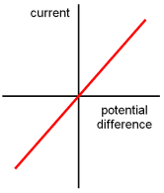
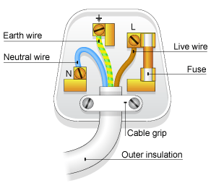
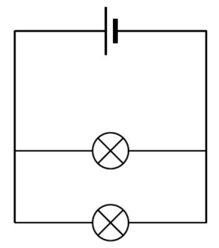
P2: Electricity
Equations:
charge flow
potential difference
power
power
resistance
energy transferred
energy transferred
Key words:
coulomb
parallel
potential difference
resistance
voltmeter
parallel circuit
series circuit
ammeter
equivalent resistance
filament bulb
dependent variable
independent variable
ohmic conductor
current
series
diode
light-dependent resistor (LDR) sensors
thermistor
earth
fuse
live
neutral
National Grid
transformer
power
Required Practicals:
Required practical: Investigate, using circuit diagrams to construct circuits, the I–V characteristics of a filament lamp, a diode and a resistor at constant temperature
Understand how an experiment can be designed to test an idea
Evaluate how an experimental procedure can yield more accurate data
Interpret and explain graphs using scientific ideas
Required practical: Use circuit diagrams to set up and check appropriate circuits to investigate the factors affecting the resistance of electrical circuits, including the length of a wire at constant temperature and combinations of resistors in series and parallel
Use a circuit to determine resistance
Gather valid data to use in calculations
Apply the circuit to determine the resistance of combinations of components
Lessons:
Electric current
Series and parallel circuits
Investigating circuits
Circuit components
Control circuits
Electricity in the home
Transmitting electricity
Power and energy transfers
Calculating power
Key concept: What’s the difference between potential difference and current?

Slide 3
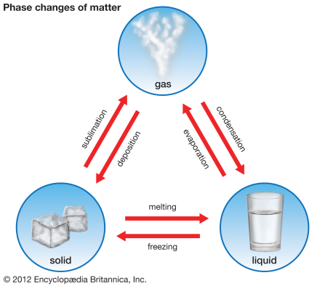
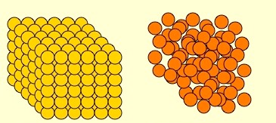
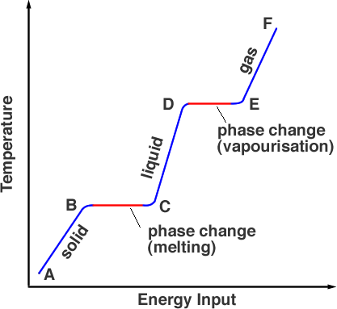
P3: Particle model of matter
Equations:
Density
Change in thermal energy
Thermal energy for a change of state
For gases: Pressure
Key words:
bonds
density
gas
liquid
particle model
solid
significant figures
resolution
boil
changes of state
condense
conservation of mass
freeze
melt
sublimate
internal energy
specific heat capacity
latent heat
specific latent heat
specific latent heat of fusion
specific latent heat of vaporisation
gas pressure
randomly
fusion
matter
vaporisation
line or curve of best fit
range scale
Required Practicals:
To investigate the densities of regular and irregular solid objects and liquids
Interpret observations and data
Use spatial models to solve problems
Plan experiments and devise procedures
Use an appropriate number of significant figures in measurement and calculations
Lessons:
Density
Changes of State
Internal Energy
Specific Heat Capacity
Latent Heat
Particle Motion in Gases
Key Concept: Particle Theory and Changes of State

Slide 4
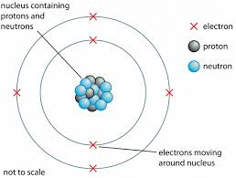
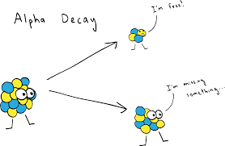
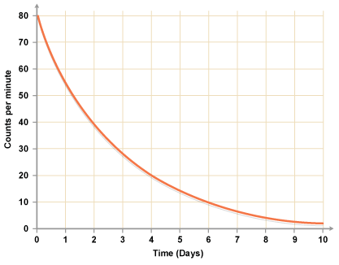
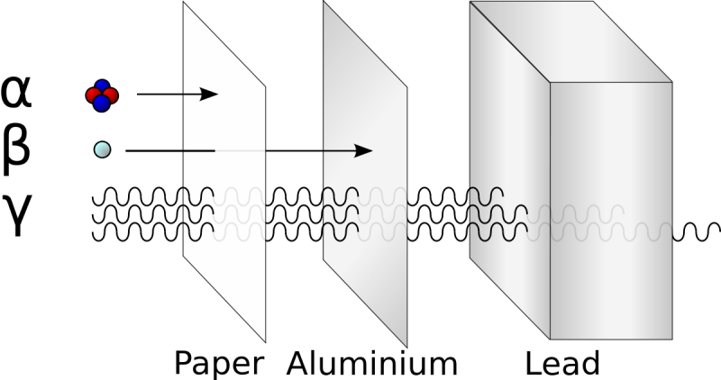
P4: Atomic Structure
Equations:
None
Key words: atomic number energy level
ionise
isotope
mass number
nucleon
activity
alpha particle
becquerel (Bq)
beta particle
gamma ray
neutron radiation
nuclear radiation
radioisotope
random
alpha decay
beta decay
nuclear equation
half-life
hazard
radioactive contamination
tracer
irradiation
mutation
peer review
atom
electron
neutron
nuclear model
nucleus
plum pudding model
proton
ratio
net decline
Required Practicals:
None
Lessons:
Atomic structure
Radioactive decay
Nuclear equations
Radioactive half-life
Hazards and uses of radiation
Irradiation
Key concept: Developing ideas for the structure of the atom

Slide 5
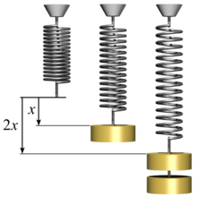
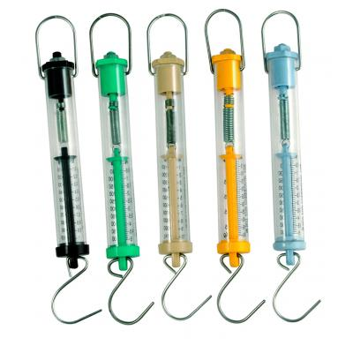
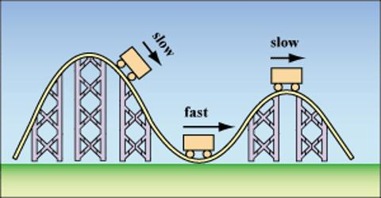
P5: Forces
Equations:
Speed
Average speed
Acceleration
Uniform motion
Weight
Resultant force
Work done
Velocity
Pressure
Moment
Extension
Key words: contact force
displacement
newtons (N) non-contact force
scalar
vector
velocity
average speed
distance-time graph
gradient
speed
tangent
acceleration
air resistance ( or drag)
deceleration
displacement
rate of change
sketch graph
velocity-time graph
uniform motion
gravitational field strength
mass
newtonmeter
weight
balanced forces
equilibrium
Newton’s first law
resultant force
balanced forces
components of a force
free-body diagram
resultant force
resolving a force
unbalanced forces gravitational mass
inertia
inertial mass
Newton’s second law
direct proportion
inverse proportion
Newton’s third law
conservation of momentum
crumple zones
momentum
rate of change
braking distance
reaction time
stopping distance
thinking distance
compression
elastic deformation
elastic potential energy
extension
inelastic deformation
limit of proportionality
linear
non-linear
spring constant
anomaly
mean
velocity
estimate
order of magnitude
round
Required Practicals:
Required practical: Investigating the acceleration of an object
Plan an investigation to explore an idea.
Analyse results to identify patterns and draw conclusions.
Compare results with scientific theory.
Required practical: Investigate the relationship between force and the extension of a spring
Interpret readings to show patterns and trends.
Interpret graphs to form conclusions.
Apply the equation for a straight line to the graph.
Lessons:
Forces
Speed
Acceleration
Velocity-time graphs
Calculations of motion
Heavy or massive?
Forces and motion
Resultant forces
Forces and acceleration
Newton’s third law
Momentum
Keeping safe on the road
Forces and energy in springs
Key concept: Forces and acceleration

Slide 6
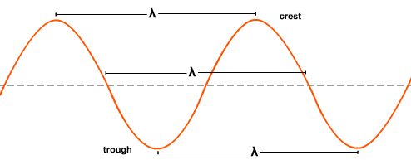
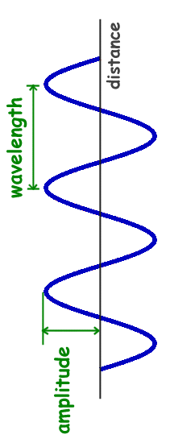
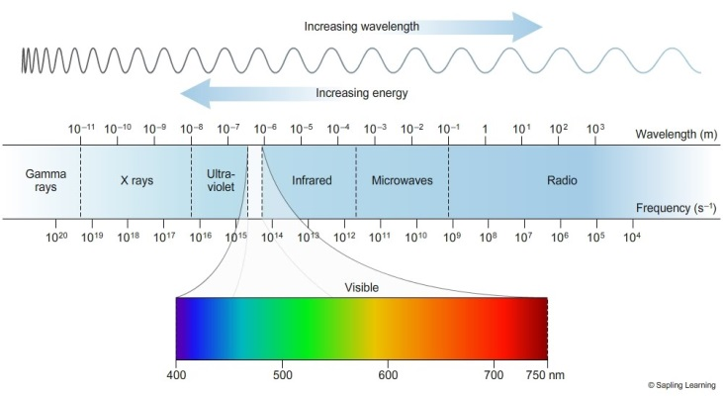
P6: Waves
Equations:
Wave speed
Speed
Magnification
Key words: amplitude
frequency
hertz
time period
wavelength
compression
longitudinal wave
rarefaction
transverse wave
absorb
amplitude
energy transfer
vibration
echo
echo sounding
speed
absorption
normal
ray diagram
reflection
refraction
transmission
electromagnetic waves
electromagnetic spectrum
longitudinal wave
transverse wave
visible spectrum
wavefront
gamma ray
radiation dose
tracer
X-ray
infrared radiation
ultraviolet radiation
emission
radiation
microwaves
radio waves
receiver
satellite
transmitter
proportional
rearrange an equation
subject of an equation
substitute
Required Practicals:
Required practical: Measuring the wavelength, frequency and speed of waves in a ripple tank and waves in a solid
Develop techniques for making observations of waves.
Select suitable apparatus to measure frequency and wavelength.
Use data to answer questions.
Required practical: Investigate how the amount of infrared radiation absorbed or radiated by a surface depends on the nature of that surface
Explain reasons for the equipment used to carry out an investigation.
Explain the rationale for carrying out an investigation.
Apply ideas from an investigation to a range of practical contexts.
Lessons:
Describing waves
Transverse and longitudinal waves
Key concept: Transferring energy or information by waves
Measuring wave speeds
Reflection and refraction of waves
The electromagnetic spectrum
Reflection, refraction and wave fronts
Gamma rays and X-rays
Ultraviolet and infrared radiation
Microwaves
Radio and microwave communication

Slide 7
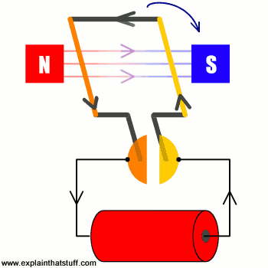
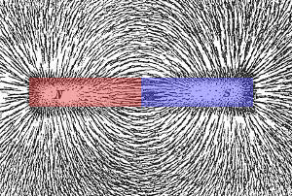
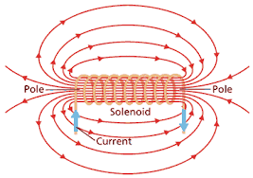
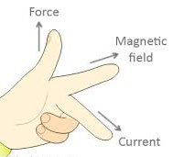
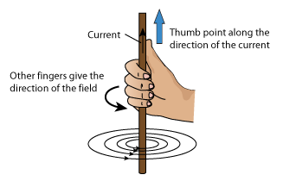
P7: Electromagnetism
Equations:
None
Key words: attract
induced magnet
magnetic field
permanent magnet
poles
repel
Earth’s magnetic field
Flemming’s left-hand rule
motor effect
solenoid
magnetic flux density
tesla (T)
split-ring communicator
induced potential difference
rearrange an equation
subject of an equation
subsitute
Required Practicals:
None
Lessons:
Magnetism and magnetic forces
Compasses and magnetic fields
The magnetic effect of a solenoid
Calculating the force on a conductor
Electric motors
Key concept: The link between electricity and magnetism

