Slide 1
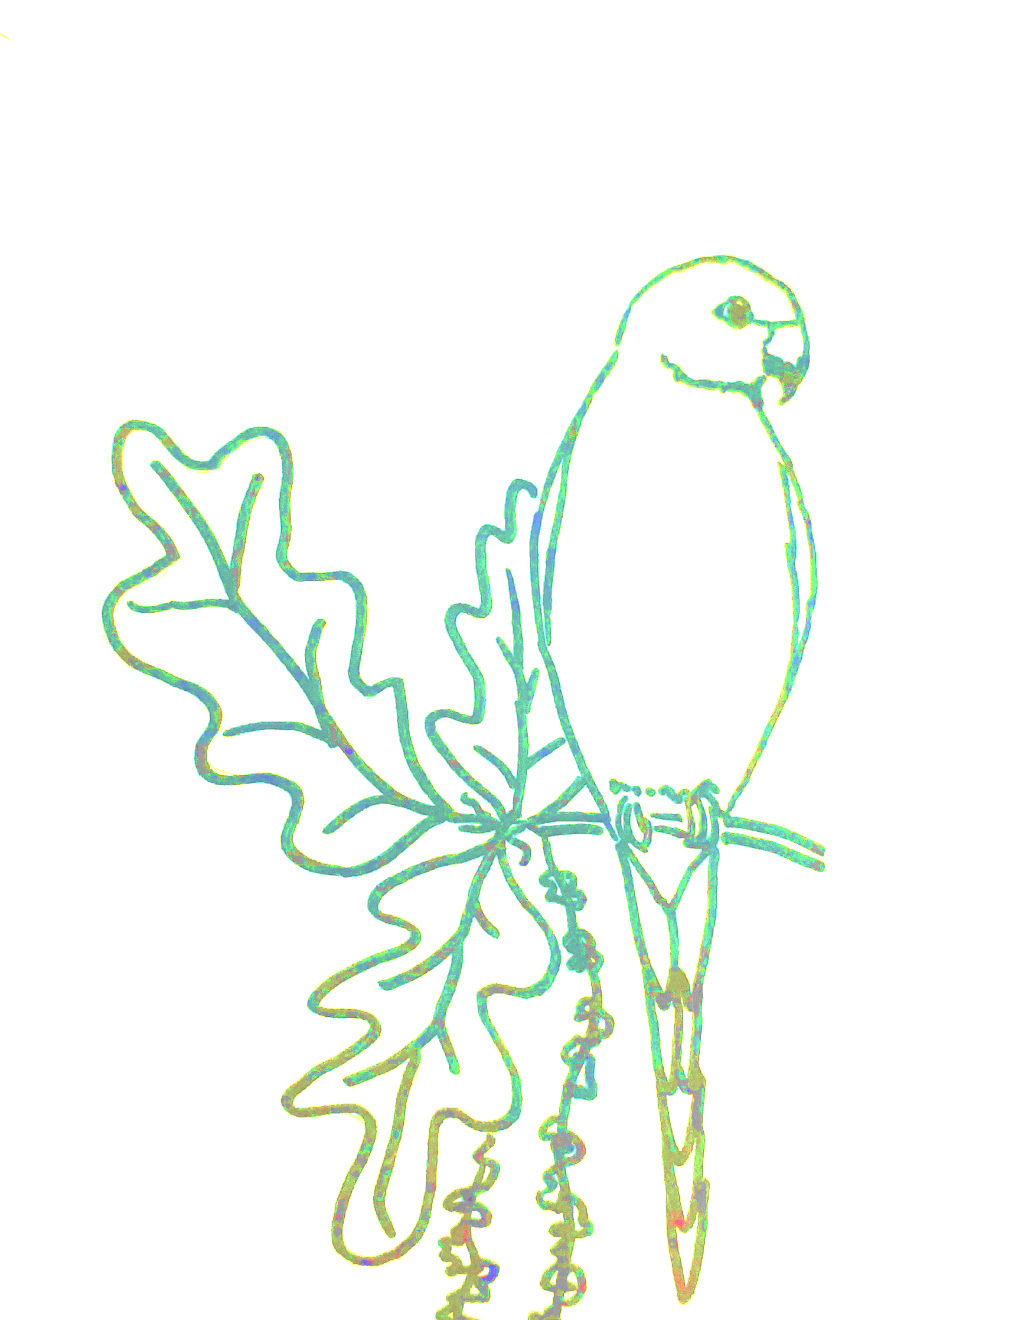
Front cover
I had a concept and tried to turn it into something, and this is how it turned out:
A four-foot drop,
The pebble falls,
Sleek and spherical,
A bead of dolomite.
A casket of water awaits,
It encases the droplet
Like woven silk
Stitching itself around.
A ripple emits,
Then another releases,
Nanometres in height,
Surge forward towards the edge of the seabed.
The sand dampens,
Revealing a strandline lighter than the last,
Yet broader,
Stronger,
Closer to the target.
The foot recoils at the touch,
The water below freezing
But it’s refreshing,
A cool in the hot,
A slight calm.
By H. Bertram, Year 9
From the English Corridor
EDITION 2
KEY STAGE 3 – PAGES 5–24
KEY STAGE 4 – PAGES 25–28
WILLIAM ELLIS SCHOOL SPRING & SUMMER 2024

Slide 2
WILLIAM ELLIS WRITERS
EDITORIAL
SPRING & SUMMER 2024
1
Year 7
Our previous English magazine featured more poetry than this edition, and all the prose writing came from Years 10 and 11. This time our current Year 9’s work is more substantially represented, and we hope you will enjoy reading some of their very recent stories, memories and poems. We have some lovely work, too, from our Year 7s and 8s. The final piece is an essay, and the student who wrote it is now in his first A level year at Woodhouse. He wrote it, however, in Year 11, in his final literature exam. Of course, we didn’t get to see it until afterwards when we asked for some top scripts back. It is such a beautifully argued essay, I have decided to include it here – partly because Year 11s should read it, but also because I think it deserves wider reading.
Thank you for reading our students’ work. Do feel welcome to send comments and contributions – by email if not a student or via email or any other reasonable means if a student.
Lorna Damms damms@williamellis.camden.sch.uk July 20th 2024
Voices from Hamlet
Dragon Stories in the oral tradition
Pages 5–8
Year 8
2
Whose story is this? A worker is the narrator in this story of standing up to exploitation.
Thoughts on the World
Pages 9–12
With thanks to:
The student writers, Ms Myrtle De Souza for her help with typing students’ work and teacher colleagues in the
English department.
Dedication:
Most of the teachers in the William Ellis English department were trained at the UCL Institute of Education and some of us were lucky enough to be taught by Anne Turvey. Even those who weren’t experienced a PGCE course which she was instrumental in shaping.
This edition is dedicated to the memory of a much admired, inspirational teacher of English and teacher of English teachers, Anne Turvey, who died in May
this year.
Year 9
3
Walking Away: two short stories
Identity poems
A selection of writing as part of our Small Things Like These unit
Writing inspired by Othello
  Pages 13–24
4
The Years Above
Creative Responses to Literature
Romeo and Juliet – an essay
Pages 25–28
SPRING & SUMMER TERM 2024
4

Slide 3
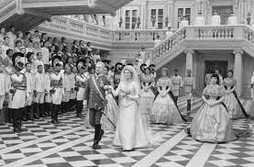
Hamlet’s Voices
1
A diary entry by one of the guests at Claudius and Gertrude’s sudden wedding:
Dearest Diary,
The journey to Denmark was cold and dreary. It took me three days to get to the palace and several of my horses died, so we had to buy some extra for good measure. I received an anonymous letter to go to the palace immediately so I jumped out of my pyjamas, leaped into my clothes, chugged down my breakfast and off I went. On my way, I felt proud and quite curious to see what was going on there.
After three blisteringly cold days, I finally arrived at the palace. The castle was surrounded in gold fenced spikes, and was taller than ever before. I was relieved that I would once again be warm. Sadly, the security took a bit longer than expected.
The wedding was fancy and the songs were quite catchy. It felt kind of weird that it was so soon after Old King Hamlet’s death. Don John and I bet whether the wedding would last two hours or three hours. I won the bet and earned 30,000,000 ducats from the waiter besides Don John.
All for today,
Benedict
(OG-M)
By Year 7 students
Our Year 7s read and take liberties with Shakespeare’s Hamlet in the spring term. These two fierce soliloquies were composed by students who were given the opening of one of Hamlet’s seven soliloquies and then let loose to devise their own imagery.
’Tis now the very witching time of night,
When churchyards yawn and hell itself breathes out
Contagion to this world. Now could I drink hot blood,
And do… the impossible! My blood ’tis empty like a volcano,
Blood and guts will drip from my hands like ice melting from a berg.
My mood is a burning sensation.
But yet again, my antic-disposition shall stand!
Claudius to hell, Gertrude to heaven for old age.
I will go out at night, past the pawns and knights
Scour the bishop and the queen and checkmate:
Kill the king.
by Owen Grabowski-Mette
’Tis now the very witching time of night,
When churchyards yawn and hell itself breathes out
Contagion to this world. Now could I drink hot blood,
And do…fire. Now the world will be mine
And Claudius will be with fear
And death is near. The clouds are fading
So is your life. But not like a mouse.
Slowly and with fear and letting it rain with THUNDER…
I feel like a storm sea moving quickly
But don’t know what to do.
The waves are pulling me back but
I’m never going to get away from Claudius.
With pain and suffering I’m turning into an earthquake shaking
With anger and when I let it out
The world will see
And be careful of me.
by Ardian Nishevci
SPRING & SUMMER TERM 2024

Slide 4
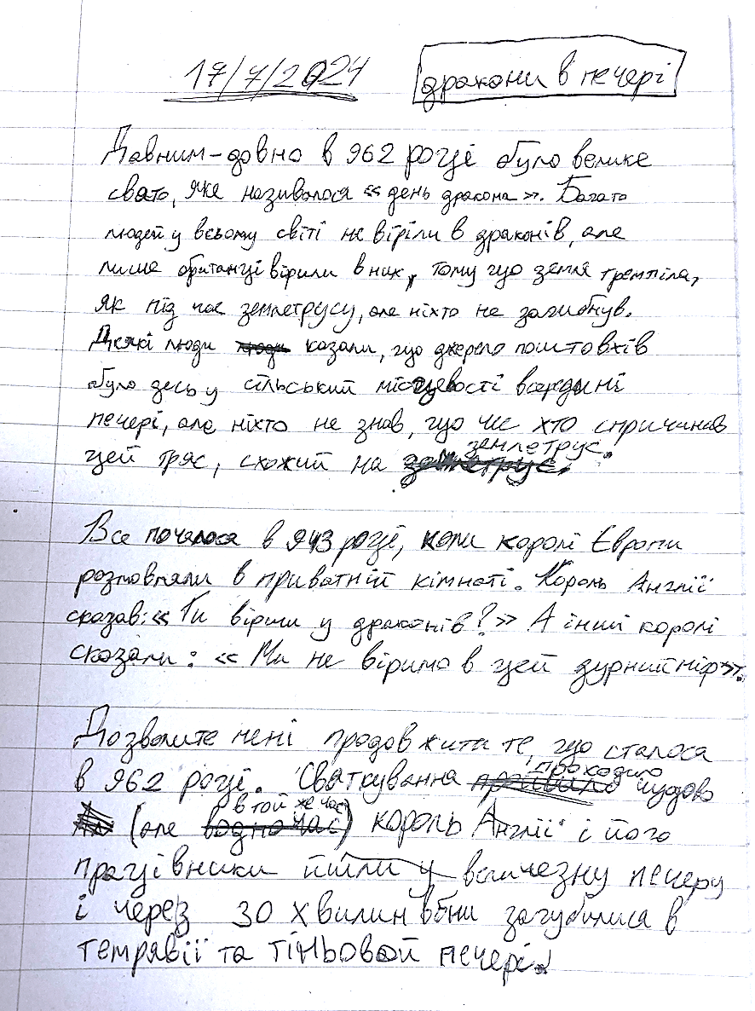
Dragon Stories
1
Dragons Underground!
A story in English and Ukrainian
by Zakhar Aliakin, Year 7
A long time ago in the year of 962 there was a huge celebration which was called the Dragon Day. A lot of people around the world didn't believe about the dragons: only Britons believed in them because the ground was shaking like an earthquake, but no one died. Some people said the source of the shaking seemed to be somewhere in the countryside inside a cave but what or who was making the earth shake like an earthquake no one knew.
One year the kings of Europe were having a talk in a private room. The king of England said, ‘Do you believe in dragons?’ and the other kings said, ‘We do not believe in this silly myth.’
Let me continue with what happened in 962. The celebration of Dragon Day was going beautifully, but at the same time the king and his workers were going in the huge cave in the countryside to find out what was happening. They went in and after
30 minutes they got lost in the dark shadowy cave.
They got lost and they were shouting for help which made it worse, and they thought there is no hope of getting out or finding the dragon. They were walking around and found something scary. It was two big legendary dragons with hairy skin which looked like gold, and this made the king so happy that he shouted ‘Yes!’ so loud that the dragons heard it and then they tried to eat him. He ran away without the evidence of the dragons and the cave was never found again.
To be continued
By Year 7 students
These miniature stories were inspired by reading a myth from ancient Britain called ‘Dragons Under Oxford’, a telling of the story of King Lludd by Amy Jeffs. These stories would have been orally passed down, developed and changed in each telling. Our Year 7s’ stories are in that oral tradition – ready to be told and embroidered upon, retold.
Dragons Under York Way by Donnie McGlashan
The 9th century was a calm century: no war, no catastrophe until the 13th of July. This day became known as the Day of the Curse. Every year a curse would be inflicted in a part of England for a month and could not be stopped unless it was destroyed. One year it happened in York Way, a small street in the parish of St Luke. York Way was an old road which, at this time, just had a small village made up of old, wooden houses inhabited by large families. It was one of the king’s favourite places to go. The first plague was a famine which was easily solved with a potion, but the next was much harder to overcome. The land was struck with a great stink, which would kill you within minutes. To overcome this, you would have to find the source, which was discovered to be in the middle of York Way, making it almost impossible to get through.
However, the Prince, known as Prince Arnold, had an idea. The country was famous for its mines, which gave him a thought to dig a hole to the source to stop the stink, as well as finding gems on the way. So twelve miners dug a hole to the source, but died before they could escape. So, in memory of them and as a second strategy, Prince Arnold fired a cannon to destroy the stench and, sure enough, it worked! But the people didn't celebrate; they thought of the lives that had been lost, but not for too long. For the third plague had begun…
No one knew for a time that the plague had begun, however, due to the coronation of the now King Arnold. You see his father had been murdered but no one knew the culprit. But suddenly people fell silent and the parades came to a halt. For in front of them, was the third plague itself, a dragon…
The townspeople screamed and ran, there were arrows being fired – it was mayhem! Then the king pulled out his sword and said, ‘There you are, Drailen! The one my foolish father tried to negotiate with! So, it was you.’
The dragon flew high and crashed down towards the king. There was nothing he could do as he was swept away as the dragon said his final words:
‘Let it be known! Our conflict is over.’
And he vanished, along with Arnold, and the plagues were a thing of the past.
The End
SPRING & SUMMER TERM 2024

Slide 5
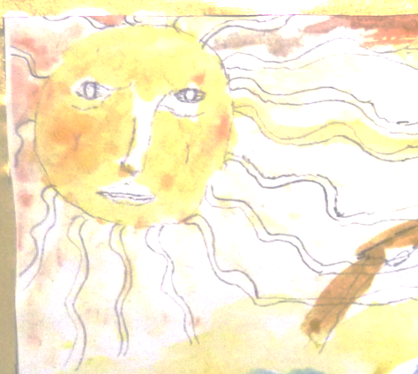
Whose story is this?
2
I take the walk to the queen – up and down, left and right. I finally reach the centre of the factory and see her in all her glory. She stares down on me as I look up. ‘Each week,’ I exclaim, the same thing happens! We are powerless to
stop it.
’The queen glares. ‘I am aware of this,’ she drawls. ‘This is why I have formulated a plan.’
I yell. We decide to bring all the factories together and tell them what to do. Some are reluctant and others proceed freely, but eventually everyone is ready to go. For the whole of the next week, we act as normal, but tension is high.
On the day, we prepare differently than usual. Our strongest sneak out the back of the factory and prepare for war. We stay inside to distract. It is deathly silent. When the hour creeps into view and the door creaks open, we are ready. We attack with all of our might, stinging it from all angles before the gas gets to us. The strongest come over and all of the factories swarm over it. The pink flesh is nowhere to be seen under this blanket of agony.
It stops shaking, tenses up, then relax is it is dead we have achieved this.
What is to happen now? We fly away to freedom, the queen leading the way to our new home, a swarm of black and yellow. We soar off into the sunset following the queen bee, unaware of our imminent queen bee dictatorship. Queen rules all. Having escaped from one trouble, weakened, we wake weakened to the next.
A short story with an unusual narrator by a Year 8 writer
With thanks to Alfred Mobbs, Year 8, for this story which he wrote for his ‘Colliding Worlds’ short story assessment.
As I wake up, I breathe out. Today is visiting day. We need to prepare. I groggily get up and move around to see the fellow workers moving around, buzzing with intensity. I work in the factory. Some say it is a great honour to work for the queen directly. I don't. I see it as a cycle: you were born, you work till your soul has been bled out and you die. All for the establishment. We supply food for the monsters. We live and work in rows and rows of white factories. Doped into submission. Every week, on the fifth day, when the sun has dragged itself above us, they come. They open the stark white doors and reap our produce, taking it with them to wherever they go. You work to survive – if not, you will be killed.
We stop preparing. I walk over to my station and start moving the sweet food to the door ready to be stolen. Each worker has a station where they work: a hexagonal corporate hole for you to do your quota. Every week is the same. ‘Morning Phil!’ I say and my neighbour replies, ‘Morning,’ and hours later we are all lined up ready for the monsters.
First comes the opening of the doors. With a slow, deep rumble the door opens. A shaft of sunlight beams in, lighting the factory. Then comes a gas with a hissing snarl and it starts pouring in. It is grey and murky and it ripples with malice. One by one we feel its effects. It is horrible. First you tense up and then you relax, paralysed into submission. Then it comes in – pink and squat with no eyes or mouth. It comes in and takes all of our hard work, disappearing in the blink of an eye. The doors close and we're plunged back into deep darkness. Every week it happens. This needs to stop.
A detail from a Daedalus & Icarus painting done by a Yr 7 in 2022
SPRING & SUMMER TERM 2024

Slide 6
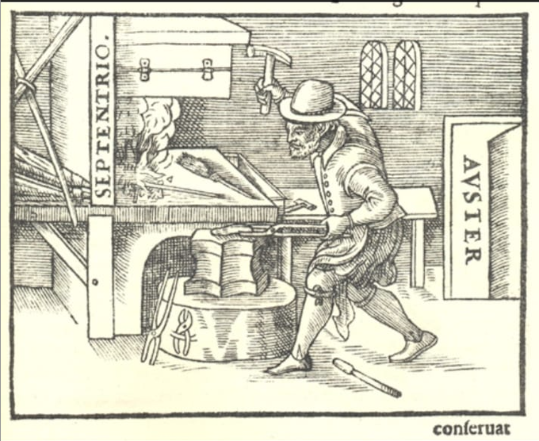
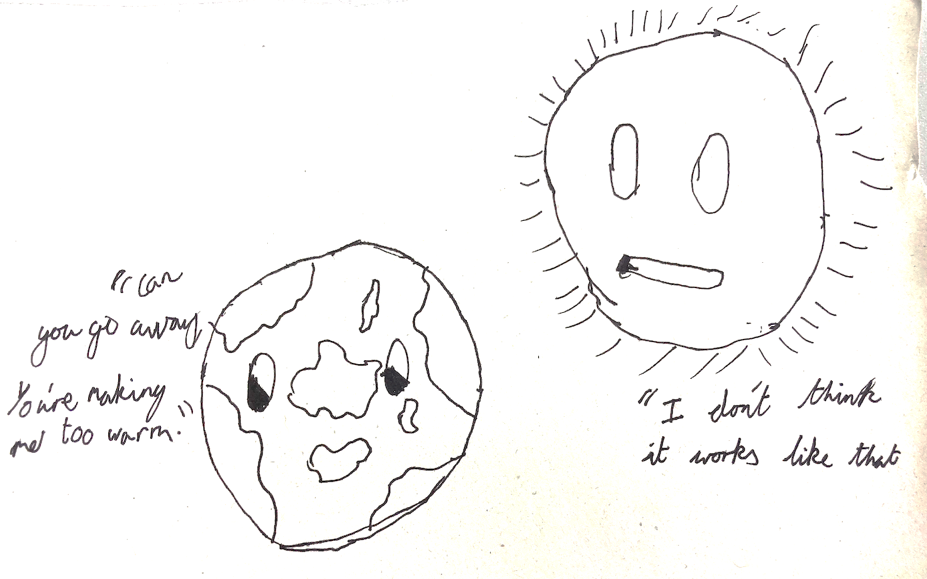
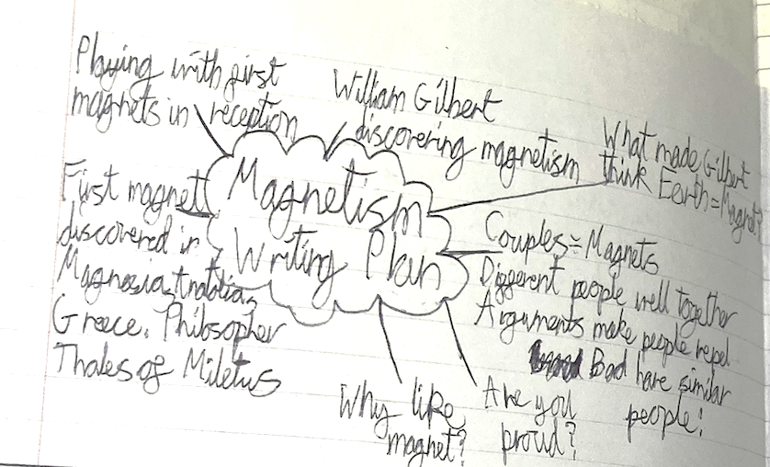
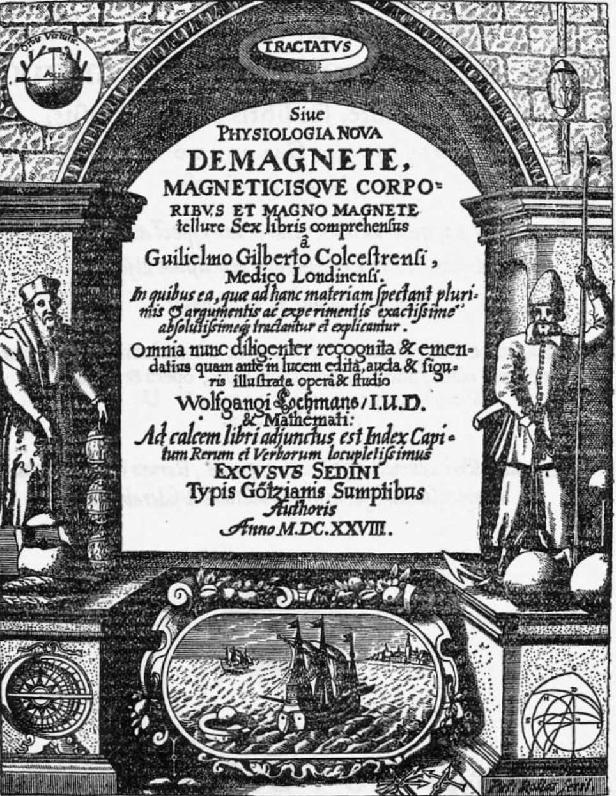








































Year 8 consider the world
2
Dear William Gilbert,
I remember my fascination over magnets from a young age. I remember playing with magnets in reception. We would see how far apart we could take two magnets and still make them attract. Also, if we could force repelling magnets together. Magnets were always fun for me, and I never grew bored.
One thing always bothered me, however. Why? How could two poles repel, and two different ones attract? How could one magnet be stronger than another? I like to think that magnets had invisible walls: some things are welcome, while others aren't allowed in. Maybe some magnets have stronger walls, or wider territory than others? I also thought of magnets like couples. Different people go well together, and similar people could often argue, or repel. For example, siblings often argue despite having similar personalities, sharing the same blood, being just as bad as each other. It is important to have a diverse world, with a balance of repel and attract.
You may not know me, but we are friends through magnetism, and I'm sure we attract.
Yours sincerely,
William
On these pages are some small pieces of writing done by Year 8 students as part of a non-fiction unit exploring individual perspectives on global or momentous events. The first was inspired by a Francis Crick letter to a young scientist and is a letter from one William to another, with William Velasco-Villalba writing to William Gilbert, the Elizabethan scientist whose work on magnetism included the discovery that the earth is a kind of giant magnet. Below Aaron O’Donaghue’s cartoon makes its own point about the state of the earth.
Dear Kim Jong Un,
My name is Felix Wharton-Vitry and I live in England. I live a normal life and I am 12 years old.
I am confused why you are threatening so many countries with your nuclear bombs. Do you realise that if you launch one of these weapons a chain reaction will start and the world will be doomed?
If you want to show how powerful your country is, treat your people better and you might gain some respect. There is no need to spend all your country’s money on things you are most likely never going to use or need.
I'm very concerned about your reckless actions with these super-weapons: the effects of using them are devastating. I would like to know why you have made these poor decisions and why you're treating yourself like a God when your country is suffering.
I know your life has been easy but how would you feel if you were a citizen of your country, starving and dying of disease? People aren't scared of you; they're scared of your reckless decisions.
I hope you change the better and gain the respect of your country.
From Félix
Meanwhile, Félix has written to Kim Jong Un, who probably isn’t reading this magazine, but ought to.
SPRING & SUMMER TERM 2024
12

Slide 7
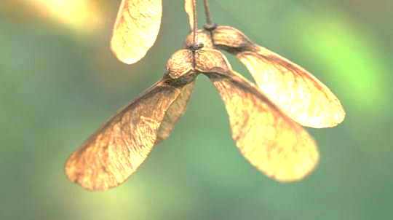
Short Stories
3
I definitely didn’t now. The taxi took another turn. I had done so much, been to so many places. Had she even left the town? Or would I find the house empty? Another speed bump as we passed the newsagent. I had written 20 different letters since then apologising and saying I would come home, with stamps and all. I hadn’t posted a single one. Past Gary’s corner. I could have called. Past the Italian place. I should have called. Onto my street. Why didn’t I call?
The taxi stopped. I handed the driver a 20-pound note and stepped out of the car. The house looked miserable, not as a place of hope and home like it once had. I stepped past the gate and hesitated. Should I? Would I? Could I? I could. I pressed the bell and heard a bit of shuffling. “Would you hold on? I have to put my dressing gown on.” As I heard my mother’s voice, I was flooded with emotions. I was ready. And then, I don’t know why, but I couldn’t. I did what I had done so long ago. I walked away.
By Year 9 students
The stories here were written in a Year 9 exam in just half an hour or so.
All the students were given is a title to use.
I can see
You walking away from me
by Seba Drinot-Boesten, Yr 9
Walking Away
For many people, if their parents owned a car, they could sense when they had returned home by the turns they would make, and the length of the road they went down. Often, whilst embraced in the soft hug of slumber, they would be jolted away as they felt the turn of the main road, or the two consecutive speedbumps next to the Tesco that made you know that you were home.
I felt just that way whilst in the taxi. The council had had 20 years to fix the roads since I last made the journey but you could still feel each pothole on each road. I stared out the window at the rain outside as I had done so many times before whilst we left the station. One thing had changed. The lady at the ticket booth had always smiled down at me when my mum went to buy tickets. My mum would tell her that I’m a bit shy and she would say I was a very cute boy. She was no longer there. Raj used to save a copy of the train magazine at his stand, and my mum would buy it for me, although I couldn’t read it, but she knew I liked it. He was no longer there,
Gary used to shout that the government is lying and we were all being tricked into buying spying devices in the form of microwaves. My mum always spoke to him
and listened, even if she thought it was all nonsense. He was no longer there.
The taxi came off the main road and proceeded further down the back streets. I had my mother’s watch on. It was a gift she had given me, originally my father’s, which I received once I became “the man of the house now he’s gone”. It never fitted my six-year-old wrist and it didn’t fit now. I thought putting it on might make me feel better about what I’d done, but it didn’t. I took it off and pushed it as far down my bag as I could.
The taxi went over the two bumps next to the Tesco. Surely by now she would have forgiven me? But had I forgiven myself? I was sure I had done the right thing then,
Walking Away
No one was watching you. Stuff that you didn’t want mummy to see or find out – oh how you were so cheeky always made me laugh.
The best thing is that you didn’t know I was watching you. Every time the lightning would bang you would always jump out your skin. I used to watch you bunk school, bunk lessons. I watched you through your GCSEs, rooting you on. Oh how I wish you could hear me.
I still remember your first boxing match. I had the best bird’s eye view. I was your number one supporter, but you never knew I was watching you. Oh how I wish you could hear me. Punch after punch. I used to hold my breath every time someone threw a punch. I was so scared for you. But that last punch landed right on your temple. It was the last punch you were ever going to feel. When I saw you lying on the canvas with your eyes shut my heart stopped. You weren’t getting up. I saw your mum in tears at home watching you on the telly. Oh how I wish it never happened.
I was screaming ‘Get up!’ but you couldn’t hear me. Oh how I wish you could hear me. I saw you walking up the white stairs to me. I just wanted to give you a massive hug. That’s when you saw me. You didn’t recognise me because I died the day you were born. I told you I was your dad. You didn’t believe me. I explained how I died and how your mother never told you how I died. I died from boxing too, I told you. You started bawling your eyes out. You are such a cheeky kid, I told you, whilst we watched your mum pray for you.
Oh how I wish you could hear me.
by Joseph Germain, Yr 9
SPRING & SUMMER TERM 2024

Slide 8
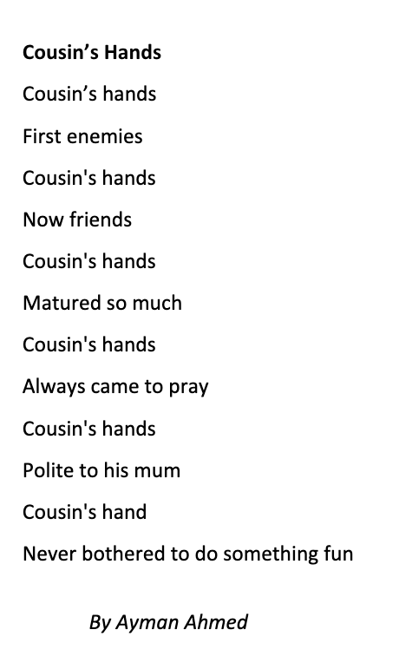
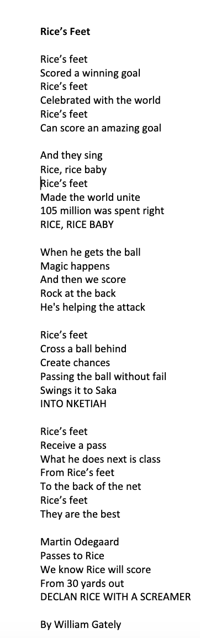
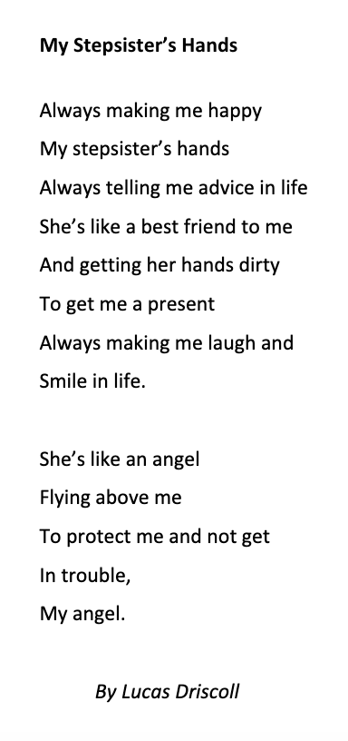
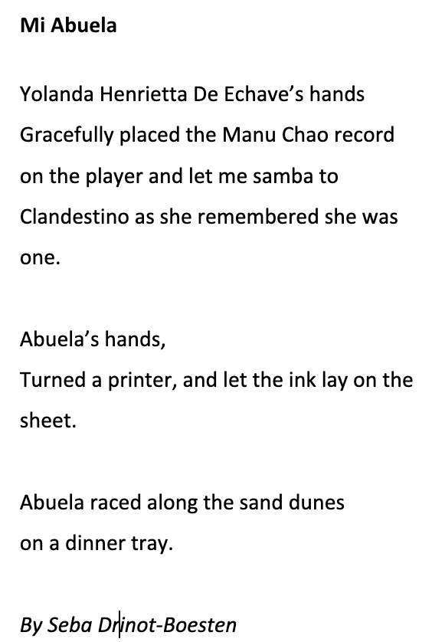
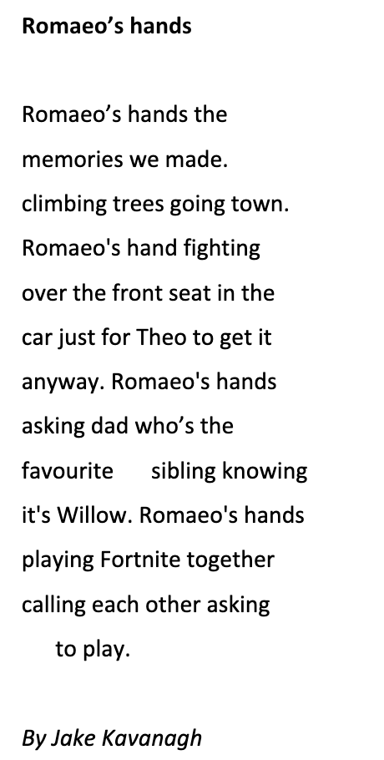
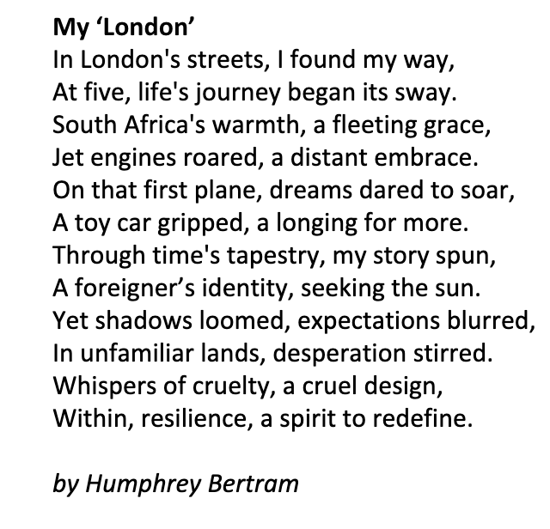
Poems written in the Identity & Poetry unit
3
Four of these poems were written after reading and discussing ‘Grandma’s Hands’ by Bill Withers. Humphrey wrote after reading ‘My City’ by George the Poet.
David Kristo, Yr 10
SPRING & SUMMER TERM 2024

Slide 9
While reading Small Things Like These
3
Baking – a memory
I stood at the kitchen table, my eyes wide with excitement as my mum sifted flour into a large bowl. The kitchen was filled with a warm light that seemed to make everything glow. I watched carefully as she measured out each ingredient with incredible accuracy not wanting to disturb her, as if there was something sacred about the way she worked. I felt a sense of happiness knowing I could eat this cake tomorrow.
Together we mixed the butter and sugar, my small hands working alongside hers, stirring until the mixture was perfect. The air was thick with the sweet scent of vanilla. My mum’s voice guided me through each step as I mixed the flour and eggs. Everything else seemed to fade away, leaving just us two in the warm kitchen as we poured the batter into a tin. The hot breath of the oven hit me in the face as I placed the tin inside.
by Rowan Lawrence
Unseasonably, this summer we have trialled a wider reading unit to bridge to the GCSE course and Year 9s have read Claire Keegan’s novel Small Things Like These set in Ireland in the 1980s and at Christmastime. The work emerging from this unit has been fantastic and includes students interviewing parents, grandparents and other adults about what they remember of the 1980s, writing in role as characters, writing passages of narrative when we have paused to consider what might happen next or to ask how the story might be told by one of the minor characters. Some of the writing is non-fiction and involves memories of preparing for special occasions, inspired by the novel’s description of the making of a Christmas cake. We also had poems which were loosely inspired by reading Robert Frost’s ‘The Road Not Taken’.
If you can’t work out what is what here, perhaps don’t worry about linking it to the novel. We have printed some fragments of work as well as longer pieces. Where work is based on a student’s lived memory, we have indicated that, too.
Baking – a memory
It was a cold start to November. Yet the streets were full of people going on with their ordinary life. As I looked out of the window, I felt a tingle in my stomach and the sunset looked like something out of a movie. For my household, it was nearing a time of celebration called ‘Dia de los muertos’ and it celebrated the lives of the dead. One thing I loved about it was the baking. It was tradition to bake a specific type of bread and we get to eat it later.
My mum told me to come to the kitchen and I couldn’t wait. After I washed my hands I started to prepare our bread. While my mum sifted the flour and cracked the eggs, I measured out the butter, found the right amount of baking powder and poured the milk. As soon as we put the ingredients together I could almost imagine the taste already, to the point where I was almost salivating. My mum lined the tin with baking paper and tied with string. I did the honour of putting the kneaded bread dough in the tin. Not a minute later as the bread was put in the oven did she tell me to go do my homework and get out of there, which I obliged with grudgingly.
I felt restless while doing my homework so I decided to sneak to the kitchen to see the bread. I hadn’t even walked in there but I could smell it. The delicious salty, fluffy bread.
‘Wow!’ I muttered under my breath. It carried the scent of love, care and life all delicately measured and placed in the dough. Something about the bread smelt better than the other years. ‘Come,’ said my mum as I tried to go unnoticed. I reluctantly went down to the living room and saw it. As we marvelled at the bread, my mum said, ‘Well there’s still another three to bake!’ with a massive smile on her face as she strolled to the kitchen.
by Raymi Saldana Rojas
Thinking before reading Small Things Like These by Joseph Hagan
Pondering this: Why are the things closest to you sometimes the hardest to see?
I think that things closest to you are the hardest to see because when things are in your bubble you trust it and let your guard down. It also makes me think of the fact that the thing closest to me is my nose and yet I can’t see it, meaning that the things around you in your daily lives you struggle to see or notice or look at properly.
Also, if you were to look at your future, it would be easier to look at the good ahead, but hard to see the small steps that you take to the finish line. So maybe this question is referring to a mental standpoint and how people are programmed to chase ahead instead of noticing the things around them, closest to them, and build themselves up. It reminds me of the children’s story we all know too well and its moral of ‘slow and steady wins the race.’
Furthermore, the things closer to us hold more significance but less wonder. For example, I do wonder how the earth was made, so maybe this question is an insight into the human emotion of wonder and trying to find answers from things furthest away.
SPRING & SUMMER TERM 2024

Slide 10
More while reading Small Things Like These
3
Eileen – a new narrative perspective by Noah Lynch
Eileen sank into the chair, delicately wrapping presents and preparing for the upcoming festivities before feeling a cold breeze brush her skin. Bill walked in, smothered in a large, rough coat and a bright scarf. Eileen stopped and glanced at Bill before continuing wrapping, ignoring his entrance.
‘I’ll be ready for mass soon,’ Bill mumbled.
Eileen sighed but produced a smile to mask her frustration. ‘It’s a bit late now, don’t you think?’ Eileen retorted.
‘We still have time,’ Bill muttered as he stumbled up the stairs. Eileen’s face sank into
her hands.
A different perspective – a man thinks about going into the church by Callum Miller
It was a cold icy mass. I was standing behind the church wearing a suit as the frozen wind brushed off my parched lips. The priest did his usual thing, telling the story of Jesus, and singing songs as a statue-like crowd stayed silent, waiting for the giant bell to ring. I turned to the door and peeked in. One thing I noticed, like a needle in a haystack, was a man with his wife and kids, everything as in a normal family, I thought, but he seemed different, he seemed distracted. Before I could hear what he was saying the choir blasted out the song ‘Silent night’ and I turned outside and looked up at the grey sky asking God what to do. But the bell rang so I did my usual thing and walked away, puzzled by the thought of the man.
After Mass – a new narrative perspective inspired by a detail in Ch. 6 by Sam Allard
Father John climbed up onto the pulpit, coughing to prepare his voice for the coming hour of mass, “Or two,” he thought “if everyone doesn’t quieten down.” Father John was a small man, balding and dull looking. He clapped his hands together and a few piped down, but not much changed.
“Sister,” he began hissing “Sister Carmel, try playing the organ.” Sister Carmel trudged over to the organ. She grabbed the girls’ attention and then began to play. Finally, the congregation’s attention was united by the choir – and what a good choir, he thought. He began looking at the girls and boys of the choir and then to their families, every family beaming with joy and pride. But the fifth girl, a girl he did not recognize at first but soon realised it was Joan Furlong, daughter of Bill, the man who ran the coalyard. The odd thing was not Joan but Bill: he had a sickly rage on this face, and he wasn’t looking at Joan, but Sister Carmel. Before he could delve further, the music ceased and his sermon began.
Sister Carmel – a new narrative perspective by Luke Gill
Sister Carmel, whose arms and throat were already sore from the music lessons, took her place at the organ, which had been freshly polished a little over two weeks before and began to wait for the townspeople to walk through the large wooden doors and begin the arduous process that was mass.
Whilst the church slowly filled its seats, the Sister thought back through the last couple of days and let her thoughts roll over one another, contemplating her role at the convent and Mother Superior’s anger after Bill had left, which the young girl had suffered the worst of.
As the morning sun rose higher, the seats reached its capacity, and the Sister knew it was time to play. She played every note almost as a release, an escape of the events over recent days. Her hand flew from one line to another until the priest whose purple robes brushed the floor just behind his feet, took his place at the altar and began mass.
Making Christmas cards – a memory
When my dad and I are getting ready to make Christmas cards, I always dread it as it is my least favourite part of Christmas. When my dad and I make Christmas cards we always homemake them from scratch.
We would take a sheet of paper and write down all the people the cards were going to. Then my dad would take down all the sheets of paper we used and put them on the paper cutter, then I would firmly grab the giant lever and bring it down on the papers’ edge, to slice off the edges. It made a satisfying ‘CRRRRR’ sound as it went down, which I always enjoyed. Now I would begin the drawing. I would get out coloured pens and draw on the front of the cards a little picture, be it of snowmen, a Christmas tree or even Father Christmas himself. Then my dad would write a message inside and put the cards into envelopes before licking to seal them. Then my dad and I would pop over to the post office and send them all over the world.
by Astor Bidmead
SPRING & SUMMER TERM 2024

Slide 11
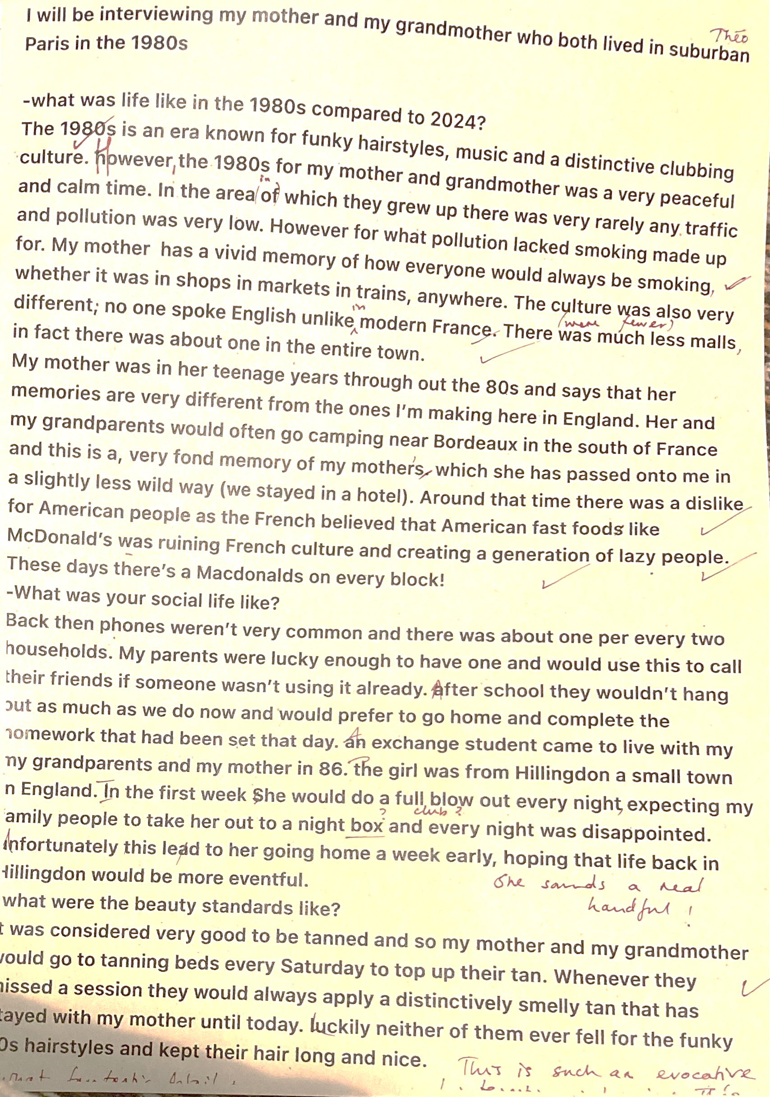
Even more while reading Small Things Like These
3
Here we have some fragments of interviews by a bundle of Year 9 students including Farris, Sam and Thèo. Thank you to their family members for answering questions about their memories of the 1980s.
Interviewing my mum about the 80s
Q: What were you doing during the 80s?
A: As I turned six at about the start and 16 by the end I was going through it all.
Q: What was school like in the 80s?
A: Like it is no.
Q: What was the miners’ strike from your perspective?
A: My Uncle Aaron worked for the miners, in safety. He had to cross the picket line every day to get to work and it was quite traumatic for the family.
Q: What was the Berlin Wall like?
A: Growing up lots of people were always talking about the Cold War but the wall falling was exciting as this whole new part of Europe was opened up.
Q: What was the Aids epidemic like?
A: There was massive fearmongering from the government, ads of giant tombstones and calling for protected sex. There was a massive amount of homophobia and a whole stigma against touching Aids patients but when Princess Diana went into a hospital and shook hands with patients, the stigma and fear shifted.
Q: What was Diana and Charles’s wedding like?
A: Up until that point the royals were seen as old and stuffy. I was in Portugal at that time and everyone in the hotel gathered round TV to watch it. I remember my granny was a royalist. She collected trinkets and scraps but when Diana came along, she made whole scrapbooks devoted to her.
“During the 1980s pop music was heavily influential and featured heavily in the 1980s cultural background, with successful musicians like Michael Jackson and Madonna.
The 1980s were very bright and people would wear bright colours, a loose top and tight jeans or pants. Also people would wear vintage clothing as fashion.
People loved to listen to pop music. Even I did too as it was influenced through advertisements like Walkman, a box we children used to listen through. Also my favourite singers were Michael Jackson and Madonna. They were perfect examples of pop artists and now have the titles of King of Pop and Queen of Pop, which even today are well known.
It was safe compared to today as you could call your street your family: your belongings wouldn’t get stolen and if you left your door open nothing serious would happen.
Internet was made in the mid 1980s but it was exclusive as it was just made. But in
1993 it became public, so I started to use it and it was useful because it only watch on TV during the 1980s as the Internet wasn’t allowed to be used by the public.”
SPRING & SUMMER TERM 2024

Slide 12
Writing inspired by the Othello unit
3
Even then the General was slightly unsettled and disturbed. It seems to me that he had something very important to go back to. But he remained solemn and assured and started to give us the orders and commands, slowly making everyone feel at ease. It was like he was fighting the tempest itself, the very worries and even the slightest bit of turbulence he countered easily. Then suddenly it stopped. We’d won, we beat the sea itself. It was a short agonising battle but I’ll never forget it.
Then getting to the end of this blood-curling, life threatening journey we received news that the Ottomans had lost their battle against the turbulent waves and sea and the war was now over without a single bit of spilt blood. Everyone was overjoyed when they disembarked, they even kissed the very soil itself. However, to me something didn’t feel right: this felt too easy. There’s got to be something to come. We had won the war against the Ottomans, the battle against the sea but what is to come and will the reaper come to collect the unsplit blood? They say he isn’t very forgiving!
Earlier in the spring term, we do a Year 9 unit comparing productions of Shakespeare’s Othello. As well as the study of the text and productions, students use creative writing to explore some of the play’s themes and characterization. Here is a selection from March and April 2024.
The Shadow of Venice by Yusuf Ahmed
In the dim light of dawn, Venice was more a painting than a city. The canvas carried the soft melodies of the waking day and the air shared its breeze in the back quiet alleys, where light was forbidden; Venice was different. Here Iago, a young man with eyes like storm clouds, moved silently. His heartbeat was a thunderous echo of betrayal and anger.
Today was the day he would reclaim his pride and honour, or so he had convinced himself. As the sun claimed its throne in the sky, spreading golden rays over the black and white skyline, Iago found himself outside the grand Othello’s estate. The weight of the dagger in his pocket pleased him, a reminder of the justice he was to serve. His uncle’s death had moved him; with every step he felt his plan drawing closer. The whispers of sweet revenge had been haunting him for nights and now they roared. Here he was at the grand oak doors of Othello’s estate.
Iago’s Backstory by Vincent Boudens
It all started with tragedy. Iago’s father had been a Venetian Army general and had fought in lots of battles in the Ottoman-Venetian War and as he was away for prolonged periods of time, Iago rarely saw this father. As such he had learned to be independent from an incredibly early age and he came to resent his father for being away for so long. As it was, Iago was often bullied by the other kids who lived in his area for his small and weak stature. His father helped in this by saying that the only good he would be able to do in the army was to be a cleaner, which just made his anger worse as he had a short temper.
Determined to prove his father wrong, Iago decided to join the army and become a great general to prove to his father how strong he was. Unfortunately, Iago was too weak to join it yet so for a few months he went to the gym every day for one hour and after some time, he went back to the recruitment centre and asked again. This time they said yes. This was the first stone in his path knocked out, but he still had a long path ahead of him filled with pebbles to walk on.
Sometime later, Iago was training at his newly bought house when suddenly he heard a knocking on his door. He answered it and there stood a military official filled with sorrow as he told Iago the news,
“Your father is dead”
Iago, after hearing this, was filled with anger as he had still not been able to prove his father fully wrong as he still needed to become a great general – as his father had been – so they could work together, side by side and prove his worth. Now, that dream would never come true.
Othello’s journey to Cyprus, as told in a letter by one of his men by Joseph Hagan
The atmosphere was daunting, as the soldiers stood awaiting the harrowing aspect of war; the brutality, the barbarity and the bloodthirstiness. Then the General came he was stoical and well assured and with his arrival accompanied a wave of admiration but also slander and rumours. However, he didn’t let this affect him and his calm demeanour and bearing stayed completely the same; I’ve never seen someone so indomitable
After I and the rest of the comrades boarded and the journey started, that’s when it all went to hell. We were half-way through the journey when the peculiar hints started, at first it was the rocking and the occasional breaking of a pot or glass then it was the screaming, the worrying and the agonising.
SPRING & SUMMER TERM 2024

Slide 13
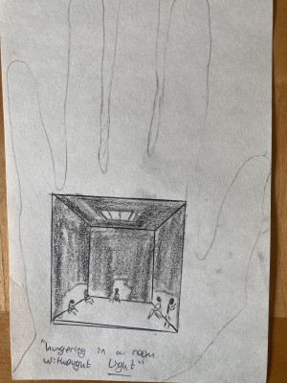
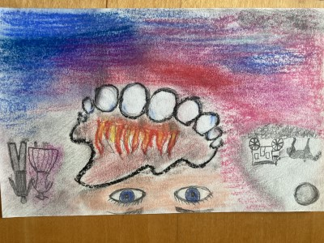
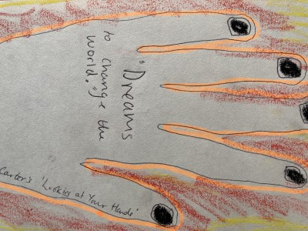
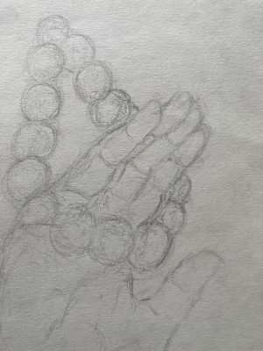
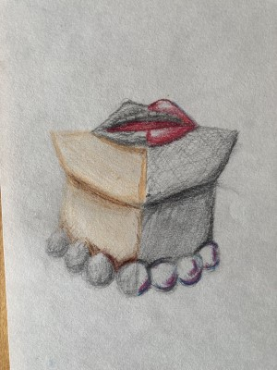
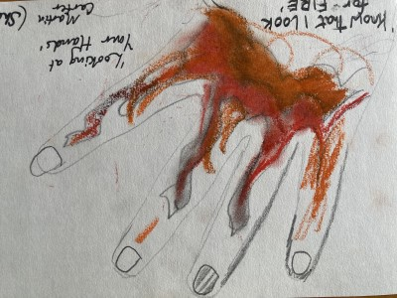
Creative Responses…
4
He ran and he ran and he ran until he ended up on a sandy shore by the sea. This made him feel quite confused as he didn’t know what this was as he had never seen anything so beautiful. He took his shoes off and put his feet in the warm sand and then in the cool water. He looked down at his feet and saw that all the dirt on his feet had been washed away by the clean water. This made him smile and laugh out loud. He was free. This was the start of his new life, and he would not ruin it this time.
At this moment, a thought came rapidly to him – the boy on the marshes. Pip was his name. He felt thankful to Pip for bringing him food and not telling on him. He wondered what would become of Pip? He remembered he was an orphan as he found him sitting down next to his parents’ grave crying. He wished he could find a way to pay that boy back. He felt guilty for jumping up on him and scaring him.
Magwitch remembered the man with yellow teeth and the scar and turned around to see what was behind him. No one was there.
Work by Year 11 students
…to literature. This is a piece of writing by Lukas in Year 11. It was a creative writing task given to him as part of the class’s revision work on the novel Great Expectations by Charles Dickens and for story writing practice for the English language GCSE.
It is followed by some paintings done by other Year 11s to help them remember interesting things in the imagery in some of the poems they have studied.
by Lukas Matheson
The Arrival
Magwitch had been on the ship for over one hundred days and so he was very excited to get off the ship because of how dark and hot it was. There were no windows and the ship smelt like rotting wood, sweat and excrement, and there were rats crawling around.
A door opened at the back of the ship, and as soon as Magwitch walked down the gangway to land he saw a beautiful blue sky and green trees: everything looked luscious, beautiful and alive in comparison to the muddy swamps of the marshes. As he stepped out of the ship he was hit by the sunshine, so different from the gloomy English weather. He felt happy and hopeful that everything would be better for him now, it was a new land, a new life, a fresh start for him and everyone else on the ship.
Suddenly, he was pushed by someone behind him. A man with crooked, yellow teeth and a scar above his eyebrow was snarling at him. For a moment, Magwitch thought his was Compeyson, but it was not his old enemy, this was a new man he had never seen before. “You! I know you! You were with Compeyson,” the man growled, aggressively. Magwitch was terrified. He thought Compeyson had escaped in London. His heart was beating like a drum, his face turned pale, he began to sweat and his legs were shaking. He didn’t want Compeyson to know where he was, so he turned around and ran as fast as he could without saying a word to the strange man.
SPRING & SUMMER TERM 2024

Slide 14
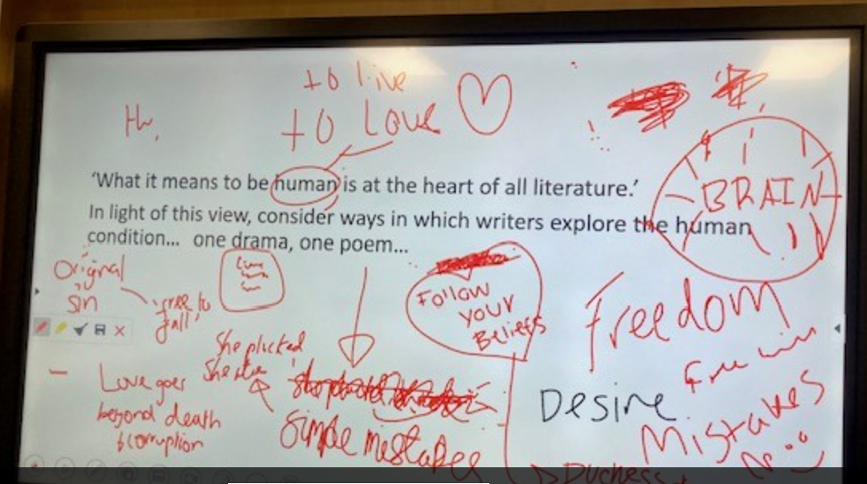
And finally…an essay
Juliet's monologue continues, becoming frenzied as she calls out “I long to die”. It sums up her desperation and morbidly foreshadows her final words to her knife, “here is thy sheath”. Shakespeare makes it seem as if there is no hope left. His constant reminders of the rigidity of society in Verona and the “consequence yet hanging in the stars” point to this moment as the last semblance of hope in this play. It is the Friar's last chance to “defy you stars”, just as it is Romeo’s when he screams that to the sky.
Shakespeare also uses this moment to show Juliet's independence and the hope created from it. Now far from wordsmithery and double entendres of the word “dead”, she physically strikes out from her role in the world and decides to take fate into her own hands. It symbolises the hope that a younger generation has for the world and the lengths that they would go to it to achieve it.
The extract ends with the Friar regaining his wits and coming up with an idea. Now partly desensitised to the idea of children threatening to kill themselves, the Friar decides to use Juliet's resolve. It is the last hope for the couple and, quite suitably, extreme. The Friar promises to give a remedy that would make Juliet appear dead and allow her to escape. The last drop of hope was of course dismissed by Shakespeare in the Prologue and acts more as a catalyst for the tragedy than a way to avoid it. Shakespeare presents hope and despair as fluid and predicated on each other. He makes it a luxury and a consequence for those willing to defy the societal structures of Verona.
Joe Gardiner’s GCSE exam essay on ’Romeo and Juliet’ from Summer 2023
Last summer’s Year 11 students were given the part of the play where Juliet rushes to Friar Lawrence in despair. She has been secretly married to Romeo for just one night but now her parents have demanded that she marry the County Paris, threatening her with being cast out on the streets or being dragged to church for a forced marriage. The exam board asked them to write about the theme of hope and despair in this scene and in the play as a whole. The examiner praised this essay for its ‘genuine personal engagement with the text’ and its ‘perceptive understanding’. Joe’s argument is built around the idea of the potential that the young protagonists have snatched away from them. It is a remarkable essay, written in just 45 minutes, and shows that sometimes even exams can provide an opportunity for students to do something creative, original and persuasive. Joe couldn’t remember what he had written until he was sent a copy of his script, but clearly it is a result of a lot of thinking and of being in the happy situation of having something to say.
Shakespeare presents hope and despair as something as quickly moving as the youths’ love. This scene comes directly after Juliet is informed of her fate by her parents. At this point, Juliet is at her loneliest after even having the Nurse abandon her. The fate of the two “star- crossed lovers” is foreshadowed throughout the extract.
The moment opens with Juliet “past hope”, having been abandoned by everybody around her. Being a young woman in Verona, this would have been incredibly difficult for her. Shakespeare has left Juliet completely without hope as even her mother “would the fool were married to her grave”. Even the Friar seems out of his depth and beyond “the compass of my wits”. This confession that even the Friar, the confidant in the play, doesn't know what to do highlights the hopelessness of the situation. It also foreshadows the failure of his plan and the death of the two lovers.
Juliet's despair redoubles as the Friar recognises the hopelessness of the situation. Juliet’s solution to “help” the knife and stab herself is a cruel reflection of Romeo's threats to the Friar after his banishment. Both lovers display the extent of their helplessness to the Friar who originally married the two hoping that it would end the “ancient grudge”. Now he is seeing the consequences of a “too sudden” love that he warned about play out in front of him. Shakespeare only really conveys the hope, and thus the despair, through more youthful characters, less rigidly set in their place in the world. Only characters that can hope, like the lovers and the Friar, are able to truly despair as they are the ones with the most to lose.
And, finally, some Year 13s leave us with their thoughts on a practice essay question on the board, preserved as an illustration of what it feels like to be finishing seven years of secondary education, ready to go out into the wide world.
SPRING & SUMMER TERM 2024

