Slide 1


WES Summer Reading Challenge
2024
Read books (including use of the Eplatform) & complete a book log
Fan art challenge
Book Report
Book bingo … and more!

Slide 2
WES Summer Reading Challenge 2024
Our WES Reading Challenges
Read a book from the challenge list and write a review to be used in our library
Use the Eplatform to read or listen to a book
Complete the Fan Art challenge for a prize in September.
Write a book review
Complete the Book BINGO challenge
Complete a book linked to a particular subject
Photograph of you reading a book in an interesting or unusual location
Over the summer holidays, try to complete at least one of the following reading challenges.
Have a careful look at the options as some are more creative – some are artistic, some are linked to particular subjects you may be interested in and some have prizes up for grabs if you complete them well!

Slide 3


Challenge 1:
Book challenge & Review
Challenge 1
Read the first book in a series
Read a book with a colourful cover
Read a book set in another country
Read a book about a journey
Read a book that was made into a film
For Challenge 1, choose one (or more!) of the options listed.
Read your chosen book and then complete a review on the table provided and hand in to Ms. Nunnery. You might be selected for a prize!

Slide 4
Challenge 1: Book Record
Name: Year/Tutor:
Challenge | Book Title & Author | Your thoughts, likes and dislikes about the book/topic
Read the first book in a series
Read a book with a colourful cover
Read a book set in another country
Read a book about a journey
Read a book that was made into a film

Slide 5

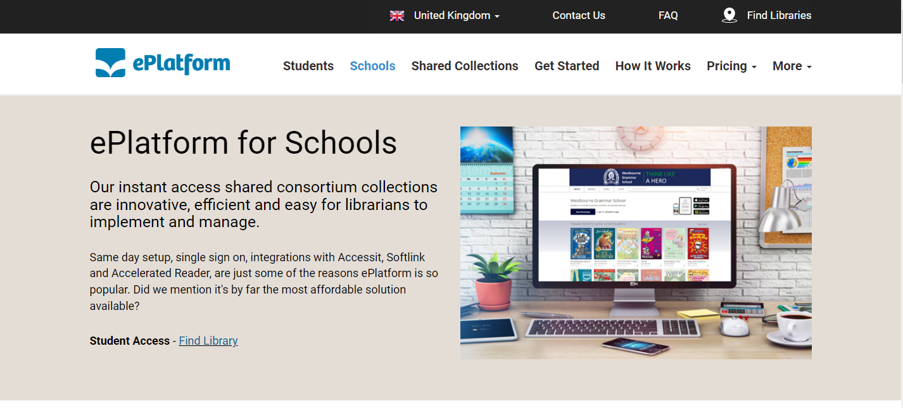
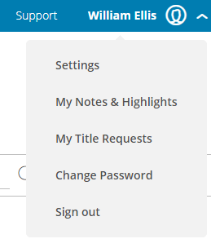

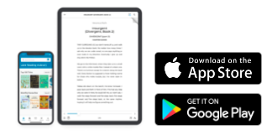

Challenge 2:
Eplatform
Eplatform
Our Eplatform access allows you to listen to audiobooks as well as read them! This challenge requires you to select at least one book or audiobook from our Eplatform and read it/listen to it over summer. Complete the reading log and hand it in to Ms. Nunnery/Miss King. You might win a prize!
Username – Firstname.Surname
Password – Library1
When you log in for the first time, please go to your profile and change your password.
You can access the ePlatform through their website or download the app through the App Store or Google Play.

Slide 6
Challenge 2: Eplatform
Name: Year/Tutor:
Book Title | Author | Your thoughts, like and dislikes about the book/topic

Slide 7
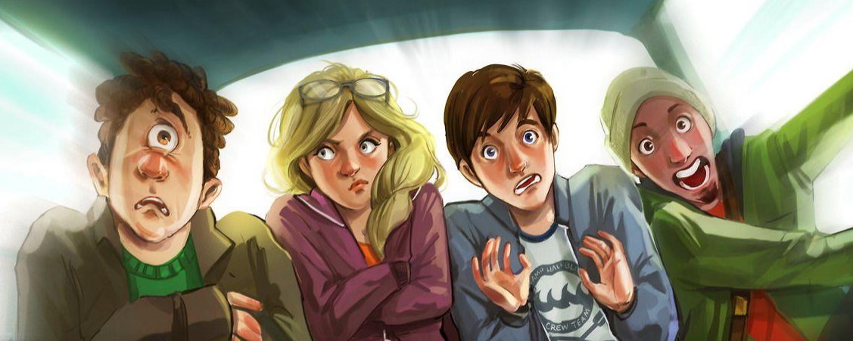
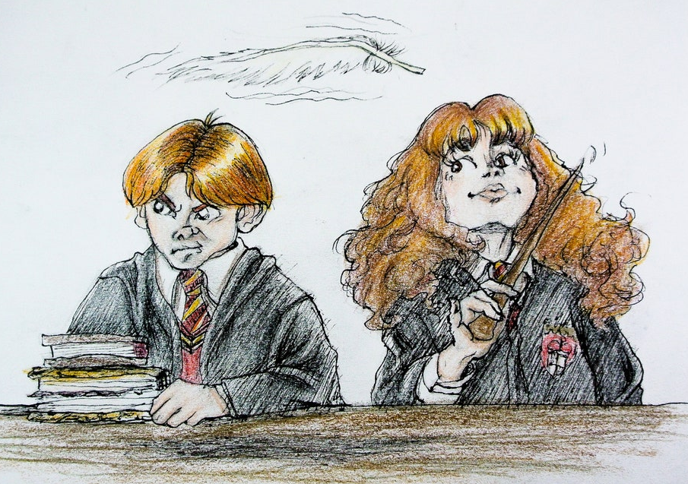


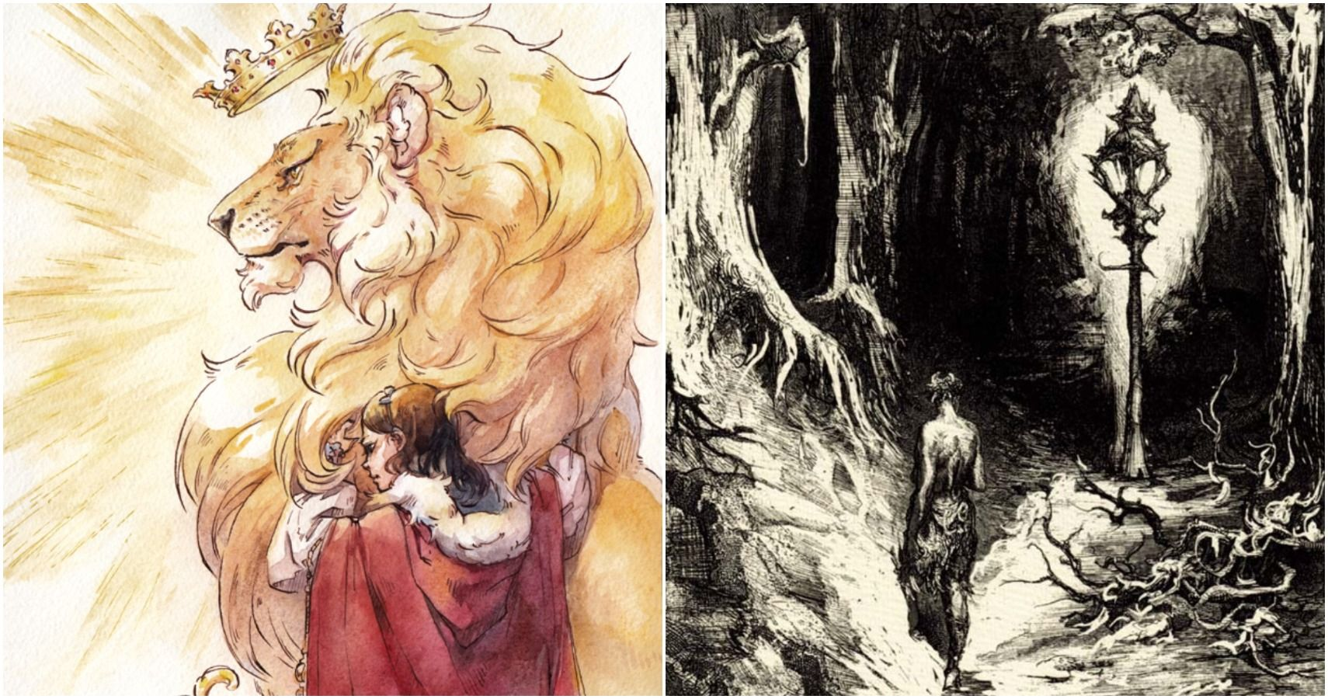
Challenge 3:
Create Fan Art
A reading challenge to have fun with!
Create your own version of a character or scene from a book you have read.
Finished pieces should be returned directly to Ms. Nunnery in the library at the start of the new year.
There will be prizes for the best entries.
Remember to put your name on your work, and mention the book you were inspired by.
Art inspired by Percy Jackson and the Sea of Monsters

Slide 8

Challenge 4:
Book Review
Read a book and write a review that could be used in our library next year to recommend the book to other students.
Extension: if appropriate, watch an adaptation of the book and compare the movie and the book. Which was better and why?

Slide 9
Challenge 5: Book Bingo!
Try to complete as many squares as possible over the summer holidays. Colour in/Cross out the square when you have done the challenge and write down the title of the book for each square. Hand your bingo card to Ms. Nunnery in the library on your return to school.
Listen to a story (YouTube, audiobook) | Read a book you wouldn’t normally choose to read | Borrow a book from our Eplatform | Read a popular book that you’ve not read before
Read a recommended book | Read for 40 minutes | Read a chapter of a book to someone in your house | Read a book based on a fairy-tale
Read a book by your favourite author | Read a graphic novel or comic book | Listen to a book read by the author (E.g.: David Walliams) | Read in your PJs
Read a book set in a school | Watch an adaptation of a book | Read a book chosen for you by a parent/carer | Read a book you have borrowed from your local library

Slide 10
Challenge 6:
Reading linked to a subject
Is there a particular subject you like in school?
This challenge requires you to read a book that is linked to your favourite subject in school.
You should then complete a task linked to the subject/book.
Some examples:
Science: re-read the book George's Secret Key to the Universe, make a comic strip about black holes?
English: Newspaper report on an incident from a book
History: Read a book based on an event in history. Complete a history fact sheet about this event afterwards

Slide 11
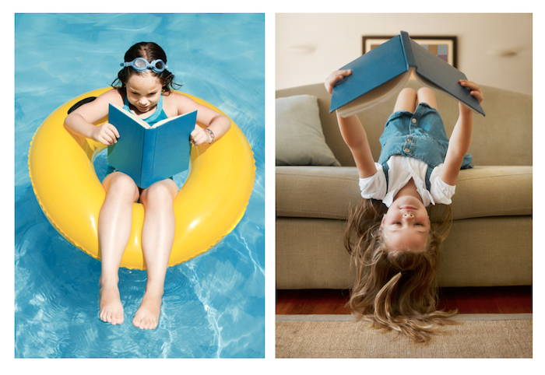
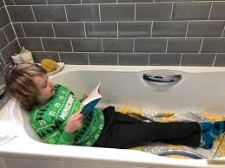
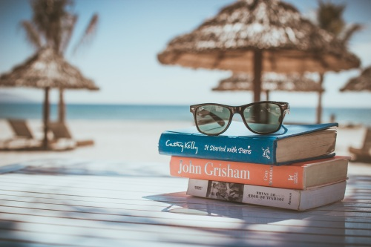
Challenge 7:
Reading Photo Challenge
Are you going on holiday this summer?
It’s the perfect time to escape with a good book, or two!
This challenge requires you to take a picture of yourself reading a book in an interesting place.
If you are not going on holiday, think creatively! Where could you (safely) take a picture of yourself reading?

